Slide 1
颠倒的课堂

Slide 2
什么是“颠倒的课堂”
为什么要颠倒课堂
怎样“颠倒的课堂”
Why Flipped Classrooms Are Here to Stay
By Jonathan Bergmann and Aaron Sams
--乔纳森·伯格曼和亚伦·萨姆斯, 2012年6月 12日
Notes:
Why Flipped Classrooms Are Here to Stay
By Jonathan Bergmann and Aaron Sams
Through much of our respective teaching careers, we had often been frustrated with students
not being able to apply the content from our lectures to their work and daily lives. Then
one day, after a combined 26 years in classrooms, we had an insight that would change our
world.
It was a simple observation: The time when students really need educators to be physically
present is when they get stuck on homework questions and need individual help. They don't
need the teacher in the room to talk at them and give them information; they can receive
that knowledge and content on their own.
We asked ourselves, "What if we prerecorded our lectures and students viewed the videos as
part of their 'homework,' and then we used the class period to help students with the
concepts they didn't understand?" Thus, our flipped classrooms were born.
How Our Flipped Classrooms Operate
We began using the flipped classroom model in 2006, while we were both teaching chemistry at
Woodland Park High School in Colorado. Our students were on a block schedule, meaning they
had 95 minutes of class time every other day. Every other night our students watched one of
our videos—either online, from a flash drive, or on DVD—as homework and took notes on what
they learned. We conducted laboratory experiments during class just like we had always done,
but instead of rushing through the lecture and setup to get to the actual hands-on work, we
were able to use the entire period to conduct in-depth scientific experiments.
In that first year, we gave the same end-of-unit tests as we had before we converted to
flipped classrooms. After comparing the test results from both years, the data showed our
students were learning more in the flipped environment than in our traditional classroom
setting. Since then, our students' test scores have continued to improve, and the anecdotal
feedback from students and parents has been extremely positive.
We would be remiss if we did not mention a few important qualifiers. First, we did not
lecture exclusively in our classes before flipping; we have always included inquiry- and
project-based learning. Second, we were obviously not the first educators to use videos as
an instructional tool. We were simply early adopters and outspoken proponents of the idea.
Third, we did not come up with the term flipped classroom. No one owns that term. Although
it has been popularized by the media, there is no such thing as the flipped classroom. There
are multiple ways to flip a class—we know of at least seven different models. We also
realize that flipping is just one of many ways to create radical transformation in the
classroom.
Why Teachers Are Flipping
Educators are increasingly pressured to find ways to reach all of their students—each with
very different needs. The personalization of education, or differentiation, has been
proposed as one solution. The movement toward personalization has much merit, but for a
single teacher to personalize education for 150 students is difficult and does not work in
the traditional, lecture-based education setting. One weakness of the traditional approach
is that not all students come to class prepared to learn. Some lack adequate background on
the material, some are uninterested in the subject, and some have simply become disenchanted
with the present educational model.
Flipping the classroom establishes a framework that ensures students receive a personalized
education tailored to their individual needs. As we present our flipped learning model to
educators around the world, we often hear comments about how it is reproducible, scalable,
customizable, and easy for teachers to wrap their minds around.
Why Flipped Classrooms Work
Flipped classrooms work for several key reasons. First, "flipping" speaks the language of
today's tech-savvy students. In a world dominated by Facebook and YouTube, the flipped
learning model allows flexibility in the use of digital devices as part of the learning
process. We encourage our students to bring their own devices to school so that they can
move along with the content at their own pace.
The flipped classroom model also helps busy students keep up with lessons. Many of our
students were missing classes because of sports and other activities at nearby schools.
Since our school is located halfway up Pike's Peak, "nearby" schools are not truly nearby
and students would spend hours traveling to and from these neighboring schools. We found
ourselves having to re-teach lessons to students who had missed lectures. The flexibility of
the flipped method allowed our traveling or otherwise absent students to keep up with the
class work.
Flipping is especially helpful for struggling students. In a traditional classroom, the
students who actively participate in class tend to get the most attention while the rest of
the class passively listens. In a flipped classroom, we walk around the room to check on
each student and can better help those who are struggling the most.
In truth, the flipped learning model helps every student to succeed, no matter his or her
abilities. For example, students can watch the instructional videos as many times as they
need to, pausing and rewinding to take notes or read Powerpoint slides at their own pace.
During class time, we can personalize the learning experience for students who are having
trouble through small-group tutoring and one-on-one instruction.
A flipped classroom leverages technology to deliver low-level instruction and increase both
student-teacher and student-student interactions. As flipped teachers, we spend our class
time answering questions, monitoring experiments, probing deeper into the content, and
guiding the learning of each student individually.
In addition, flipping tends to improve classroom discipline. In a traditional classroom,
bored or unruly students can cause major distractions. In flipped classrooms, these students
no longer have an audience for their misbehavior and boredom is banished through small group
and hands-on activities.
These examples are just a few of the reasons why teachers around the world have incorporated
aspects of the flipped learning concept into their classroom settings—and why we believe
the flipped model is here to stay.
http://www.edweek.org/tm/articles/2012/06/12/fp_bergmann_sams.html?
tkn=WPCC1Rxu4%2FbCFsj3iEU3%2Bqk97aMS3xc0jkgq&cmp=clp-sb-edtech

Slide 3
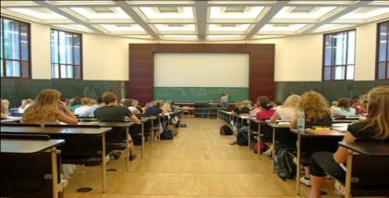
Transmition
传统的教学
知识传授 ：在教室内
知识吸收与掌握：在教室外
通常，学生需要克服学习中的重点难点时
教师往往并不在现场

Slide 4
如果知识传授和知识内化的环境颠倒过来，学习的有效性将改变…

Slide 5
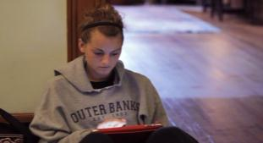
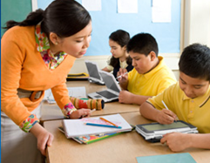
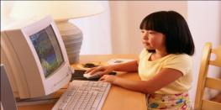
颠倒的教室
知识传授 ：在教室外
知识吸收与掌握： 在教室内

Slide 6
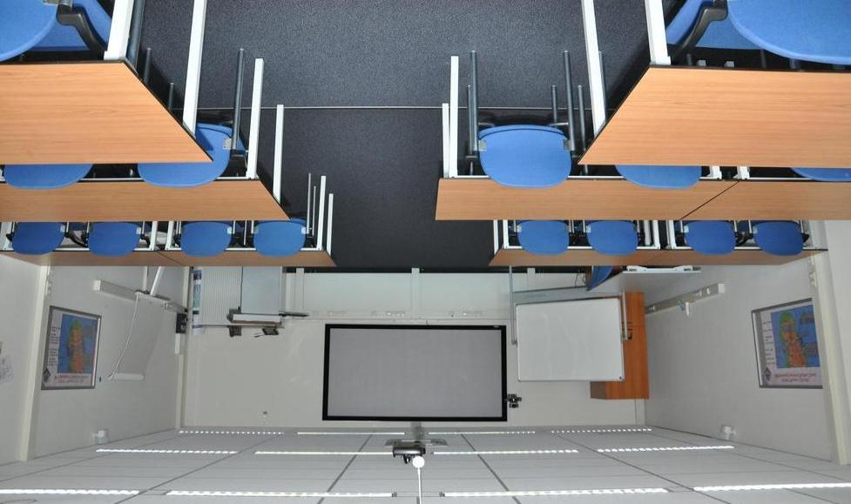
颠倒的课堂
The flipped classroom

Slide 7
美国林地公园高中（ Woodland Park High School ）
科学教师 乔纳森·伯格曼和亚伦·萨姆斯 （ Jonathan Bergmann and Aaron Sams ）
Notes:
In the spring of 2007, Jonathan Bergmann and Aaron Sams, two science teachers at Woodland Park High School in Woodland Park Colorado, USA, decided to record their lectures and assign them as homework to their students, who would watch them online or on DVD, and then do the practice exercises (which used to be ‘homework’) in class with their teachers’ support. They first called their experiment Pre-Vodcasting model, from video podcasts, and then Reverse Instruction, and only much later, in 2010, Karl Fink set up a blog about the Flipped Classroom and Dan Pink used the term Flipped Class in his blog. The idea has since spread throughout the USA and the world.

Slide 8
2006年，我们观察到，学生真正需要教师在身边帮助的时候，是他们在做功课遇到问题卡住的时候。学生并不需要老师在教室里给他们讲授和传递信息，他们可以自己学习知识内容。
于是，我们考虑改变课堂教学的方法，“如果我们预先录制好课堂讲授内容，让学生把观看视频学习作为家庭作业的一部分。然后，我们利用课堂教学的时间，帮助学生弄清楚他们不懂的概念，不是更好吗？”
于是，我们的“颠倒的课堂”就诞生了。
--乔纳森·伯格曼和亚伦·萨姆斯, 2012年6月 12日
Notes:
Why Flipped Classrooms Are Here to Stay
By Jonathan Bergmann and Aaron Sams
Through much of our respective teaching careers, we had often been frustrated with students
not being able to apply the content from our lectures to their work and daily lives. Then
one day, after a combined 26 years in classrooms, we had an insight that would change our
world.
It was a simple observation: The time when students really need educators to be physically
present is when they get stuck on homework questions and need individual help. They don't
need the teacher in the room to talk at them and give them information; they can receive
that knowledge and content on their own.
We asked ourselves, "What if we prerecorded our lectures and students viewed the videos as
part of their 'homework,' and then we used the class period to help students with the
concepts they didn't understand?" Thus, our flipped classrooms were born.
How Our Flipped Classrooms Operate
We began using the flipped classroom model in 2006, while we were both teaching chemistry at
Woodland Park High School in Colorado. Our students were on a block schedule, meaning they
had 95 minutes of class time every other day. Every other night our students watched one of
our videos—either online, from a flash drive, or on DVD—as homework and took notes on what
they learned. We conducted laboratory experiments during class just like we had always done,
but instead of rushing through the lecture and setup to get to the actual hands-on work, we
were able to use the entire period to conduct in-depth scientific experiments.
In that first year, we gave the same end-of-unit tests as we had before we converted to
flipped classrooms. After comparing the test results from both years, the data showed our
students were learning more in the flipped environment than in our traditional classroom
setting. Since then, our students' test scores have continued to improve, and the anecdotal
feedback from students and parents has been extremely positive.
We would be remiss if we did not mention a few important qualifiers. First, we did not
lecture exclusively in our classes before flipping; we have always included inquiry- and
project-based learning. Second, we were obviously not the first educators to use videos as
an instructional tool. We were simply early adopters and outspoken proponents of the idea.
Third, we did not come up with the term flipped classroom. No one owns that term. Although
it has been popularized by the media, there is no such thing as the flipped classroom. There
are multiple ways to flip a class—we know of at least seven different models. We also
realize that flipping is just one of many ways to create radical transformation in the
classroom.
Why Teachers Are Flipping
Educators are increasingly pressured to find ways to reach all of their students—each with
very different needs. The personalization of education, or differentiation, has been
proposed as one solution. The movement toward personalization has much merit, but for a
single teacher to personalize education for 150 students is difficult and does not work in
the traditional, lecture-based education setting. One weakness of the traditional approach
is that not all students come to class prepared to learn. Some lack adequate background on
the material, some are uninterested in the subject, and some have simply become disenchanted
with the present educational model.
Flipping the classroom establishes a framework that ensures students receive a personalized
education tailored to their individual needs. As we present our flipped learning model to
educators around the world, we often hear comments about how it is reproducible, scalable,
customizable, and easy for teachers to wrap their minds around.
Why Flipped Classrooms Work
Flipped classrooms work for several key reasons. First, "flipping" speaks the language of
today's tech-savvy students. In a world dominated by Facebook and YouTube, the flipped
learning model allows flexibility in the use of digital devices as part of the learning
process. We encourage our students to bring their own devices to school so that they can
move along with the content at their own pace.
The flipped classroom model also helps busy students keep up with lessons. Many of our
students were missing classes because of sports and other activities at nearby schools.
Since our school is located halfway up Pike's Peak, "nearby" schools are not truly nearby
and students would spend hours traveling to and from these neighboring schools. We found
ourselves having to re-teach lessons to students who had missed lectures. The flexibility of
the flipped method allowed our traveling or otherwise absent students to keep up with the
class work.
Flipping is especially helpful for struggling students. In a traditional classroom, the
students who actively participate in class tend to get the most attention while the rest of
the class passively listens. In a flipped classroom, we walk around the room to check on
each student and can better help those who are struggling the most.
In truth, the flipped learning model helps every student to succeed, no matter his or her
abilities. For example, students can watch the instructional videos as many times as they
need to, pausing and rewinding to take notes or read Powerpoint slides at their own pace.
During class time, we can personalize the learning experience for students who are having
trouble through small-group tutoring and one-on-one instruction.
A flipped classroom leverages technology to deliver low-level instruction and increase both
student-teacher and student-student interactions. As flipped teachers, we spend our class
time answering questions, monitoring experiments, probing deeper into the content, and
guiding the learning of each student individually.
In addition, flipping tends to improve classroom discipline. In a traditional classroom,
bored or unruly students can cause major distractions. In flipped classrooms, these students
no longer have an audience for their misbehavior and boredom is banished through small group
and hands-on activities.
These examples are just a few of the reasons why teachers around the world have incorporated
aspects of the flipped learning concept into their classroom settings—and why we believe
the flipped model is here to stay.
http://www.edweek.org/tm/articles/2012/06/12/fp_bergmann_sams.html?
tkn=WPCC1Rxu4%2FbCFsj3iEU3%2Bqk97aMS3xc0jkgq&cmp=clp-sb-edtech

Slide 9
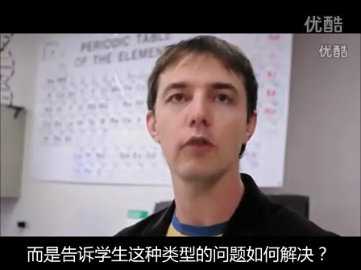
美国林地公园高中（ Woodland Park High School ）
2006年，科学教师乔纳森·伯格曼和亚伦·萨姆斯（ Jonathan Bergmann and Aaron Sams ）为学生录制在线视频课程。
学生晚上在家观看教学视频，第二天同学一起在教室做实验和作业，遇到问题有老师和同学可以请教。
这跟传统的“老师白天在教室上课，学生晚上回家做作业”的方式正好相反，所以被称为“颠到的课堂”，并广泛流传开来。
Notes:
In the spring of 2007, Jonathan Bergmann and Aaron Sams, two science teachers at Woodland Park High School in Woodland Park Colorado, USA, decided to record their lectures and assign them as homework to their students, who would watch them online or on DVD, and then do the practice exercises (which used to be ‘homework’) in class with their teachers’ support. They first called their experiment Pre-Vodcasting model, from video podcasts, and then Reverse Instruction, and only much later, in 2010, Karl Fink set up a blog about the Flipped Classroom and Dan Pink used the term Flipped Class in his blog. The idea has since spread throughout the USA and the world.

Slide 10
观看教学视频
学习笔记
讨论问题
做实验
反馈
总结
练习和作业
课前
课中
课后
颠倒的课堂结构

Slide 11
颠倒的课堂如何运作
科罗拉多州的林地公园高中，学校实施模块化课程表，每隔一天上化学课95分钟。
在上课的头一天晚上，学生可以通过网上、或者U盘、DVD观看我们的讲授视频， 并做学习笔记。
在课堂上，学生用课堂时间进行深入的科学实验和讨论，完成作业，教师给予指导。

Slide 12
颠倒的课堂教学模式的特点
学生可以根据自己的理解程度，反复观看教学视频和PPT，可以多次暂停，倒带，做笔记或阅读。
课堂上，教师可以通过小组辅导、1对1教学等方式，帮助每一位学生理解教学内容。
颠倒的课堂使师生之间、生生之间的互动更深入，教师在课堂上可以回答问题、监控实验、探讨更深的内容，并单独指导每个学生的学习。
--乔纳森·伯格曼和亚伦·萨姆斯, 2012年6月 12日

Slide 13
颠倒课堂的效果
经过两年的试验结果进行比较，数据表明，学生在颠倒的课堂环境中比传统的课堂学习效果更好，
学生的考试成绩不断提高，学生和家长的反馈非常肯定。

Slide 14
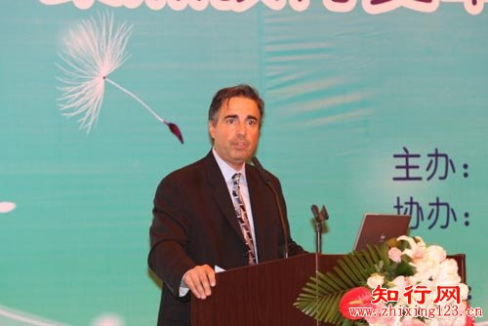
颠倒课堂蓬勃兴起
颠倒的教室，是指教育者赋予学生更多的自由，把知识传授的过程放在教室外，让大家选择最适合自己的方式接受新知识；而把知识内化的过程放在教室内，以便同学之间、同学和老师之间有更多的沟通和交流。
——英特尔全球教育总监Brian Gonzalez

Slide 15
越来越多的学校实施颠倒的课堂

